Slide 1

Emerging Technologies in Business
Pioneering the Future of Commerce

Slide 2
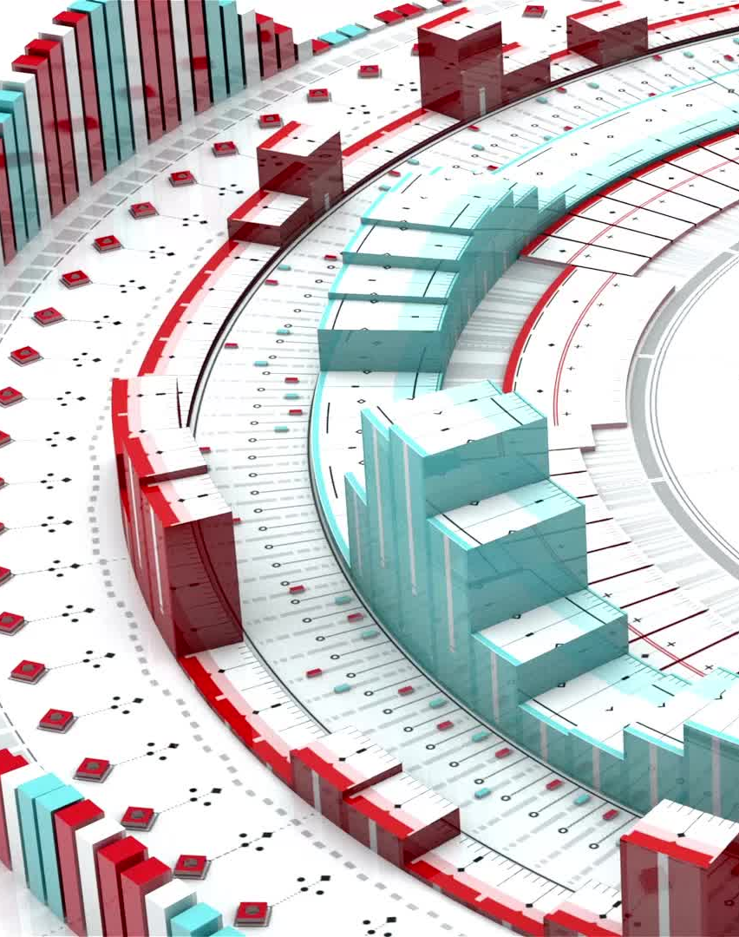
Introduction
In recent years, the landscape of global business has undergone a profound transformation driven by the rapid development and adoption of emerging technologies. These innovations are not only revolutionizing operational processes but also redefining customer engagement, business models, and competitive strategies.

Slide 3

1. Artificial Intelligence (AI)
Artificial Intelligence (AI) has emerged as a cornerstone of technological innovation in business. AI encompasses a range of technologies that enable machines to mimic human intelligence, such as learning, reasoning, problem-solving, and language understanding.

Slide 4
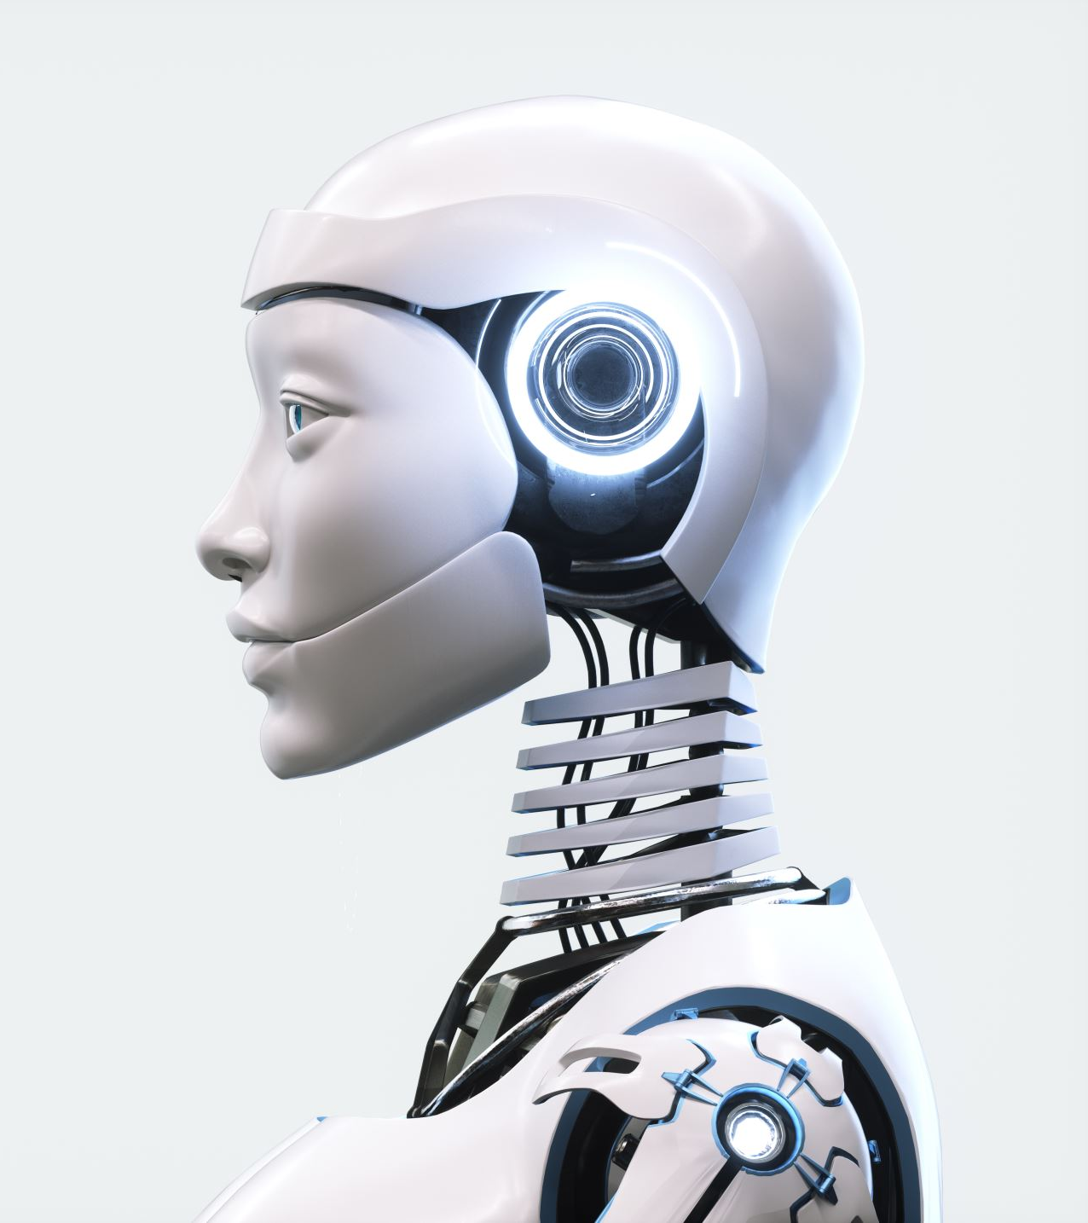
Applications of AI
- Customer Service: AI-powered chatbots and virtual assistants (like Siri, Alexa) provide 24/7 support, enhancing customer experience while reducing costs.
- Data Analytics: AI algorithms analyze vast datasets to uncover insights, forecast trends, and inform decision-making.
- Automation: AI automates repetitive tasks in manufacturing, supply chain management, and administrative functions, increasing efficiency.

Slide 5
Challenges and Future of AI
While AI offers significant benefits, issues such as data privacy, ethical considerations, and algorithmic bias pose challenges. Future developments are likely to focus on explainable AI, enhancing transparency, and integrating AI seamlessly into business operations.

Slide 6
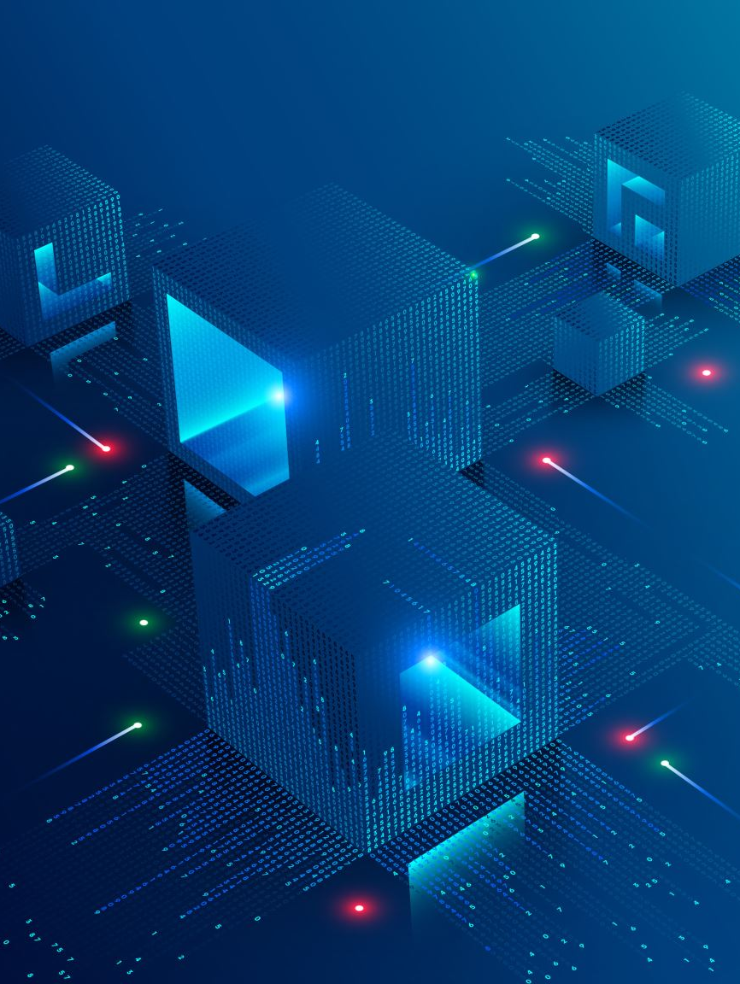
2. Blockchain Technology
Blockchain is a decentralized, distributed ledger technology that records transactions across multiple computers securely and transparently. Its inherent features of immutability and decentralization make it a transformative tool for various industries.

Slide 7

Applications of Blockchain
- Finance: Blockchain underpins cryptocurrencies like Bitcoin and enables secure, transparent transactions, reducing reliance on intermediaries.
- Supply Chain Management: Blockchain enhances traceability and authenticity verification of products, reducing fraud and counterfeiting.
- Smart Contracts: Self-executing contracts automatically enforce agreements when predefined conditions are met, streamlining processes.

Slide 8
Challenges and Future of Blockchain
Despite its potential, blockchain faces scalability issues, regulatory hurdles, and energy consumption concerns. Future innovations may focus on integrating blockchain with other emerging technologies and developing sustainable solutions.

Slide 9

3. Internet of Things (IoT)
IoT refers to the network of interconnected physical devices embedded with sensors, software, and connectivity, enabling data exchange and automation.

Slide 10
Applications of IoT
- Smart Manufacturing: IoT sensors monitor equipment health, predict failures, and optimize maintenance.
- Retail: IoT devices track inventory levels in real-time, improving supply chain responsiveness.
- Healthcare: Wearable devices collect health data, facilitating remote monitoring and personalized medicine.

Slide 11
Challenges and Future of IoT
Security risks, data privacy, and interoperability are key concerns. Advancements are expected in edge computing and enhanced security protocols to support broader IoT integration.

Slide 12

4. 5G Connectivity
The advent of 5G technology promises significantly faster data transmission speeds (10-20 Gbps), lower latency, and increased network capacity.

Slide 13

Applications of 5G Technology
- Enhanced Mobile Experiences: Improved streaming, gaming, and real-time communication.
- Industrial Automation: Facilitates real-time control of autonomous vehicles, robotics, and remote machinery.
- Smart Cities: Supports interconnected infrastructure such as traffic management, energy grids, and public services.

Slide 14
Challenges and Future of 5G
Deployment costs, regulatory issues, and infrastructure requirements are hurdles. As 5G matures, it will enable more sophisticated applications like widespread IoT deployment and enhanced augmented reality. Development of 6G, 7G..

Slide 15

5. Augmented Reality (AR) and Virtual Reality (VR)
AR and VR technologies overlay digital content onto the physical world or create entirely immersive environments, respectively.

Slide 16
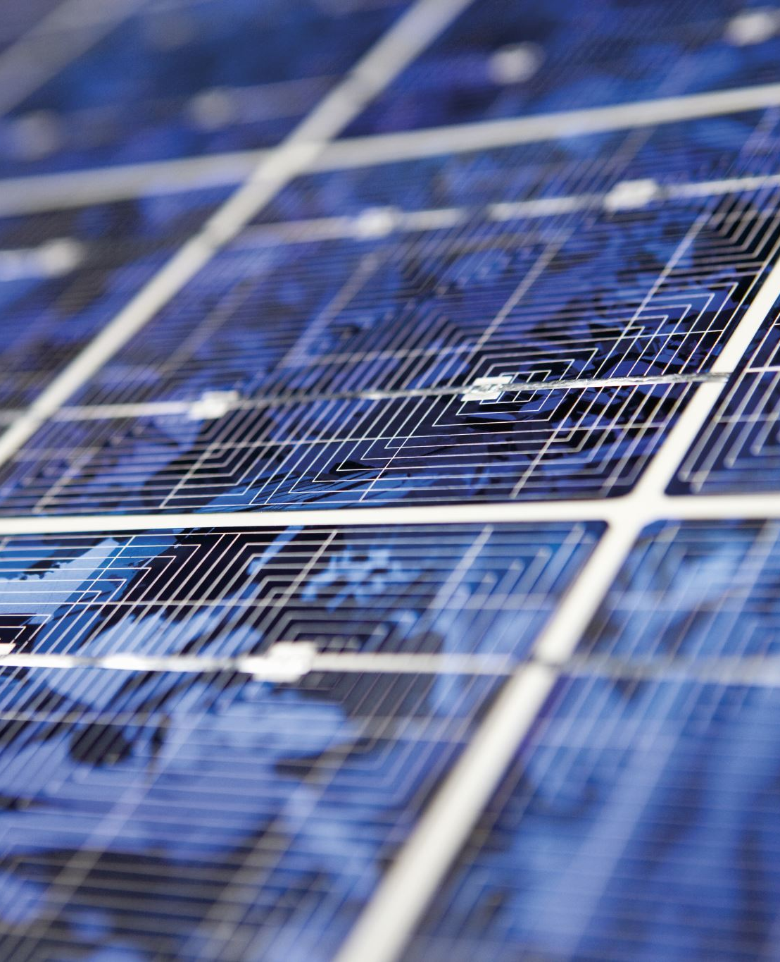
Applications of AR and VR
- Marketing and Retail: Virtual try-ons and immersive showrooms enhance customer engagement.
- Training and Education: Simulated environments provide safe, cost-effective training across industries.
- Design and Prototyping: Architects and engineers visualize projects in 3D before construction begins.

Slide 17
Challenges and Future of AR and VR
High costs, hardware limitations, and content development are barriers. Advances in hardware and software are expected to make AR/VR more accessible and integrated into daily business operations.

Slide 18

Conclusion
Emerging technologies are undeniably shaping the future of business, offering unprecedented opportunities for innovation, efficiency, and competitive advantage. However, they also pose challenges related to security, ethics, and implementation costs. Businesses that proactively adopt and adapt to these technologies will be better positioned to meet evolving customer expectations and navigate the complexities of a rapidly changing digital environment. As these technologies continue to evolve, their integration will foster a more interconnected, intelligent, and responsive business ecosystem, ultimately driving sustainable growth and value creation in the global economy.

